Slide 1
AFB VIRTUAL SEMINAR INITIAL BRIEFING ON PROPOSED CHANGES TO THE SENIOR MANAGERS REGIME 17 JULY 2025

Slide 2
Speakers
Polly James
Global Practice Group Co-Leader Financial Services Disputes and Investigations
polly.james@bclplaw.com
+44 (0) 20 3400 3158
Katherine Pope
Partner
Employment & Labor
katherine.pope@bclplaw.com
+44 (0) 20 3400 3533
Notes:
Polly

Slide 3
Session outline
1
Timeline to 15 July 2025 and context to the current proposals
Overview of 3 consultations published on 15 July – how do they fit together?
HM Treasury
FCA
PRA
3
Key points from HM Treasury proposals
Key points from FCA proposals
Key points from PRA proposals
Next steps
2
4
5
6

Slide 4
SM&CR Reform: Timeline to 15 July 2025
Government announced that HM Treasury, FCA and PRA would begin reviews of the SMCR
Dec 2022
Mar 2023
HM Treasury Call for Evidence
FCA and PRA Joint Discussion Paper DP1/23: Review of the Senior Managers and Certification Regime
Closing date for feedback on both documents was 1 June 2023
Jul 2025
HMT Treasury Consultation Paper: Reforming the Senior Managers & Certification Regime
FCA Consultation Paper CP25/21: Senior Managers & Certification Regime Review
PRA Consultation Paper CP18/25: Review of the Senior Managers and Certification Regime

Slide 5
Context – The UK growth agenda
Today, I have placed financial services at the heart of this government’s growth mission…
At Mansion House last year, I said we must regulate for growth and not just for risk…
…and we are delivering on that commitment…
…while continuing to protect financial stability…
…so that the benefits of a thriving and growing financial services sector can be realised for people all over Britain.
And I am streamlining the Senior Managers and Certification Regime…
…reducing the burdens it imposes on firms by 50%...
…and slashing approval timelines…
…so you can bring in talent to your business more quickly.
Chancellor of the Exchequer Rachel Reeves delivered her second Mansion House speech on the evening of Tuesday 15 July 2025
Notes:
This is the overall ambition – to make SMCR only half as burdensome as it is now.

Slide 6
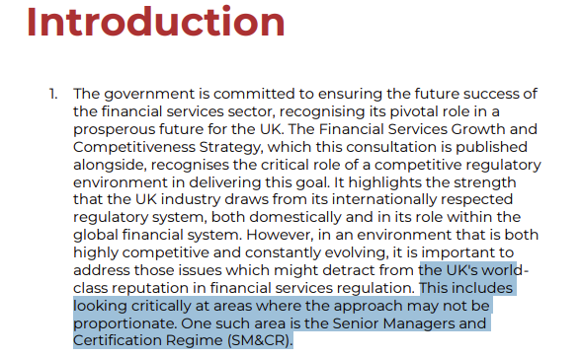
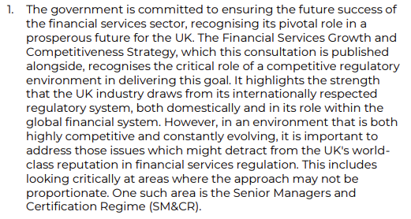
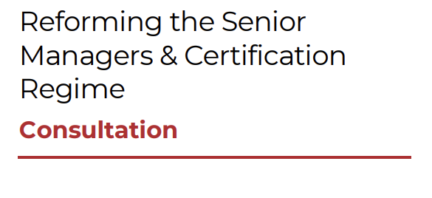
In HM Treasury’s own words

Slide 7
Overview of the three consultations published on 15 July – how do they fit together?
HM Treasury – Consulting on proposed legislative changes
PRA and FCA are consulting on interim rule changes, pending legislative change – “Phase 1”
PRA and FCA are also consulting, in anticipation of legislative changes, on further rule changes – “Phase 2”
PRA and FCA are asking for feedback and suggestions now on both Phase 1 and Phase 2 changes

Slide 8
Key proposals from HM Treasury: SMCR legislative change
Senior Managers
Regime
Certification
Regime
Conduct
Rules
Reduce the number of SMFs that require regulator pre-approval
Have some SMF appointments approved by firms, and only notified to regulators
Allow regulators to decide which SMFs they need to pre-approve
Consider a system of ‘passporting’ for SMFs
Remove prescriptive legislative requirements relating to Statements of Responsibilities
To remove the Certification Regime from legislation entirely
But NB this does not mean that the Certification Regime will disappear!
It will become a creature of regulatory rules rather than of legislation
To remove the obligation to provide training on the Conduct Rules
Potentially to remove the obligation to notify regulators of breaches of Conduct Rules
Notes:
Legislative changes proposed: repeal of provisions of the Financial Services and Markets Act 2000 that were introduced post-financial crisis by the Banking Reform Act 2013, to create the SMCR
SMF provisions: context is that ror the 2024-25 financial year, the PRA approved 1,130 applications while the FCA approved 5,264. There is scope for reform to significantly reduce the number of pre-approvals that need to be sought from the regulators, without undermining the policy objectives of the SM&CR, and the government proposes two key changes to the legislative framework to support this. The first is to make changes to the legislation to provide regulators with greater flexibility in how they define Senior Management Functions. The second is to make it possible for regulators to focus pre-approval on some senior manager roles, while for others, firms could conduct checks themselves and notify regulators of new appointments.

Slide 9
Key points from Bank of England / PRA proposals
Senior Managers
Regime
Certification
Regime
Conduct
Rules
Clarification of the 12-week rule:
12 weeks are extended to cover the period during which PRA is considering a permanent approval application
Table of examples showing how the 12-week rule works in various scenarios
Extension in scope of SMF7 to include controllers
Ahead of removal of the legislative basis for the Certification Regime in FSMA, PRA proposes to clarify its expectations concerning the annual certification assessment
PRA cannot currently remove the requirement to conduct an annual fitness and propriety assessment, as this is a legislative requirement
Extension of Senior Manager Conduct Rules to individuals performing SMFs under the 12 week rule
(who currently are only subject to the Individual Conduct Rules in those circumstances)

Slide 10
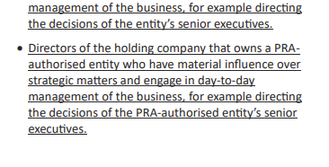
Proposed new PRA guidance on individuals who should be approved by PRA as SMF7
Notes:
Call out “for example directing the decisions” – this is v important

Slide 11
FCA’s list of its own proposals – Phase 1 (pre-legislative change) – CP para 1.9
Improve the efficiency of the 12-week rule, which allows someone to cover for a Senior Manager without being approved, under certain conditions
Streamline the Senior Management Function (SMF) approval process, including planning potential changes to processes and communications
Increase the validity period of criminal record checks for SMF applications
Allow more time to report updates to Statements of Responsibilities
Remove overlap in certification roles and provide guidance on annual certification to help firms streamline the process
Allow more time for firms to update specified Directory information
Provide guidance in areas such as: the applicability of key SMF roles; allocation of Prescribed Responsibilities (PRs); and application of Conduct Rules and related reporting requirements
Change guidance about the period in which firms should provide regulatory references about individuals upon request from a hiring firm
Raise the thresholds for becoming an Enhanced SM&CR firm
Notes:
But note that there are some important proposals to change the guidance on regulatory references hidden in the back of the paper in the Appendix on draft rules that are not in this list, so you could miss them if you don’t read all the way through – Katherine will explain now.

Slide 12
FCA ‘Phase 1’ proposal to amend the 12-week rule

Slide 13
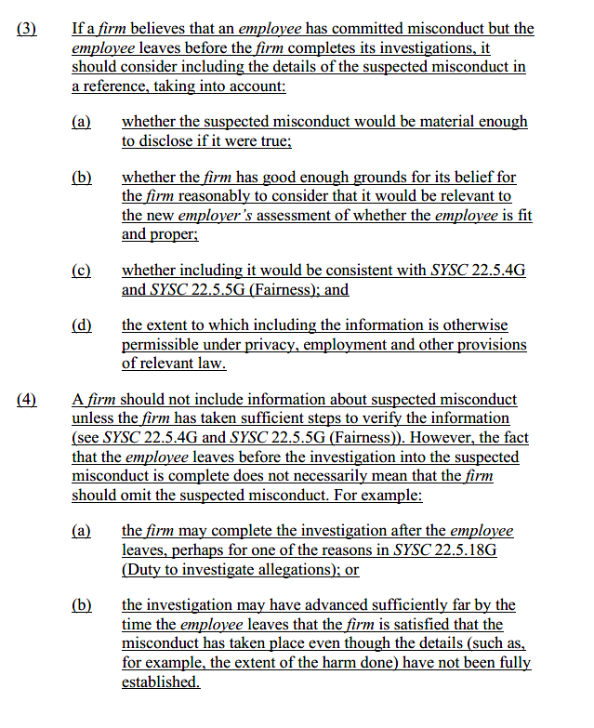
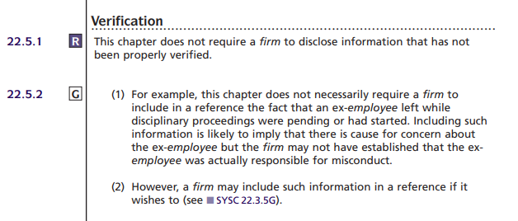
FCA proposals on regulatory references
Verification

Slide 14
FCA proposals on regulatory references
Fairness

Slide 15
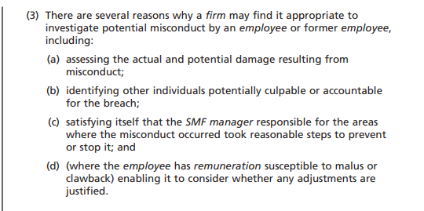
FCA proposals on regulatory references
Duty to investigate
allegations

Slide 16
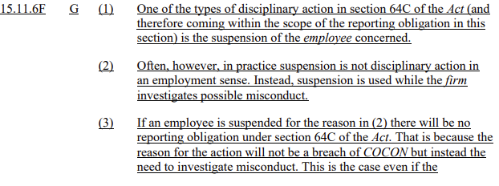
FCA ‘Phase 1’ proposal to clarify guidance on reporting suspension of an individual

Slide 17
FCA proposals – Phase 2 (post-legislative change)
Key changes we would explore to further reduce regulatory burden include looking at how we can:
Reduce the number of SMF approvals, by removing SMF roles or reducing pre-approvals
Provide more flexibility to appoint interim SMFs before seeking approval by expanding the use of the 12-week rule
Further streamline the SMF assessment process, e.g. the documents that are requested and the relevant systems
Reduce the frequency of submission of SoRs, review our list of PRs, and simplify the Management Responsibilities Maps
Design a streamlined regime to replace certification in a way that minimises burden and complexity while ensuring fitness and propriety of individuals
Remove the Directory and explore with industry alternative ways to ensure consumers have other sources of information they require
Streamline Conduct Rule breach reporting
Notes:
These are the big changes that will make a real difference to you – these all require legislative change to be able to action.
When?? “When Parliamentary time allows”

Slide 18
Next steps
Deadline is 7 October 2025
All three consultations are open for 12 weeks for industry comment
2025

Slide 19
Questions

Slide 20
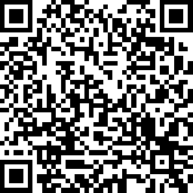
PLEASE SCAN QR CODE TO PROVIDE FEEDBACK

